Slide 1
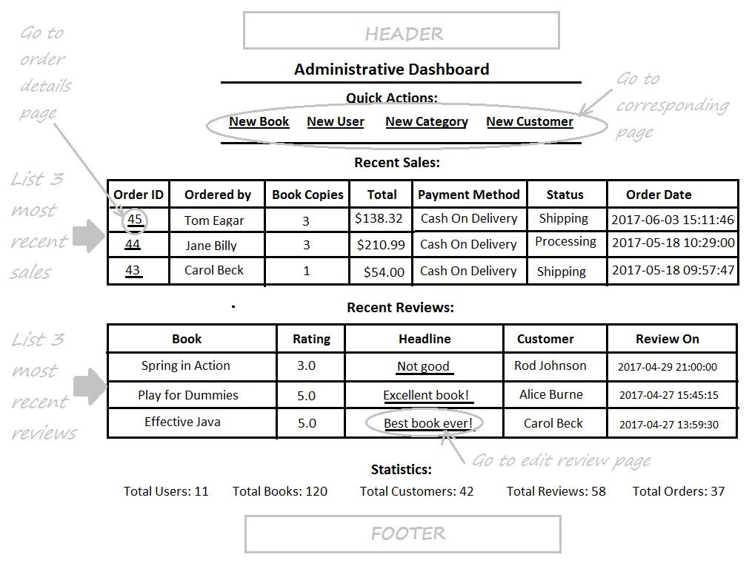
Complete Admin Home Page

Slide 2
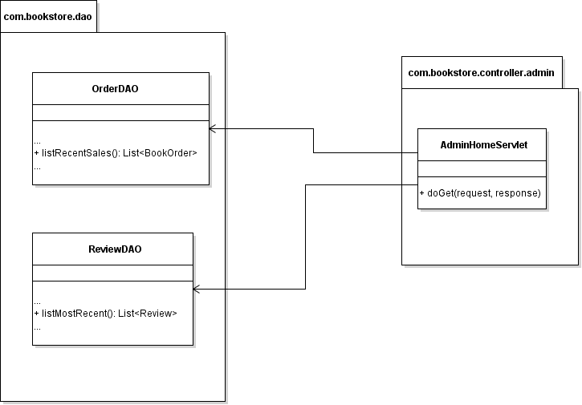
Class Diagram

Slide 3
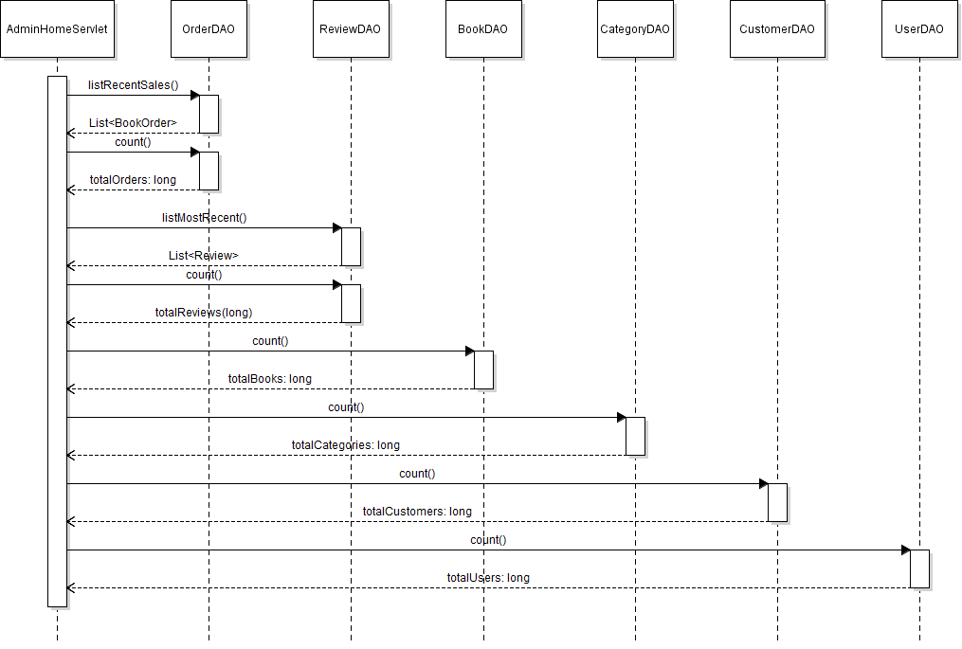
Sequence Diagram: View Admin Home Page

